Slide 1


PHENIX PWG Meeting
Run 15 pp J/ψ Multiplicity Analysis
PHENIX HI PWG Meeting
Zhaozhong Shi
Los Alamos National Laboratory
03/17/2022
1

Slide 2
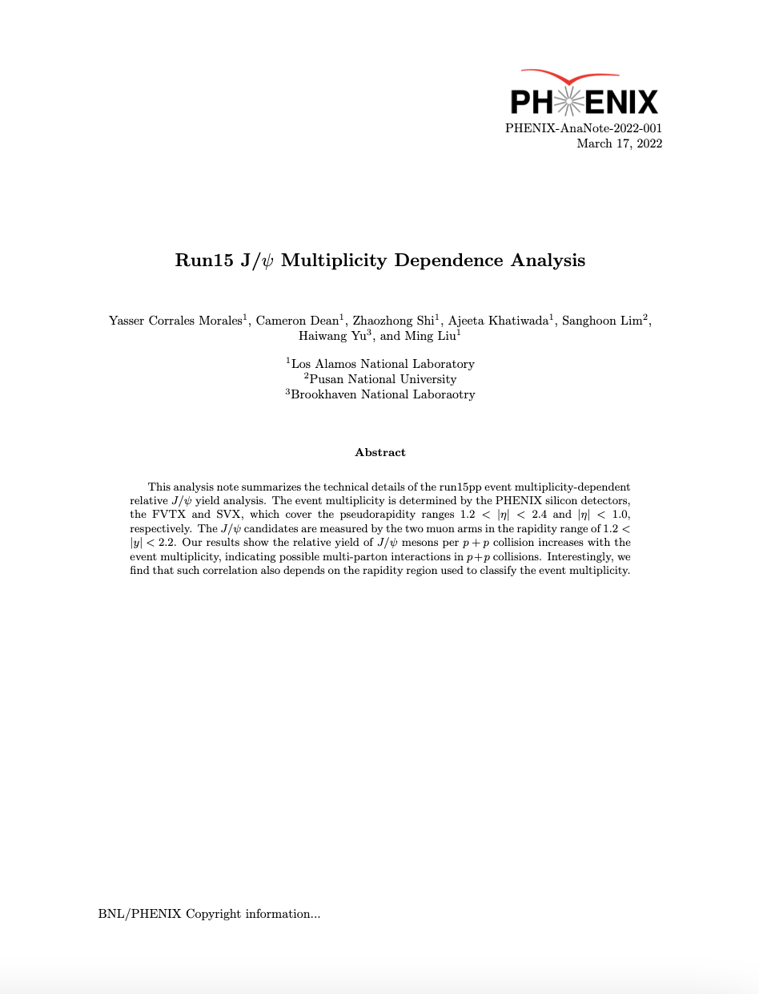
Overview
Improvement since last meeting:
Enhance dataset statistics for full 2015 pp dimuon data sample
Refine fit strategies
□ Converge the fits
□ Improve the fitting performance
□ Reduce signal extraction systematics
Estimate muon matching efficiency to the FVTX
□ Remove auto-correlation in the same FVTX arms
Include J/ψ trigger systematic uncertainties as an additional source
Improve double collision model estimation
Refresh the final results and update the analysis notes
□ Ready for preliminary to present in QM 2022
2

Slide 3
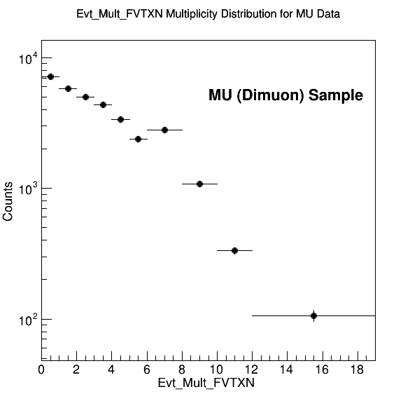
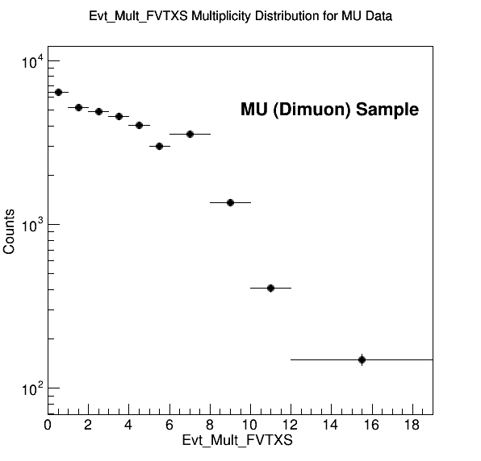
Enhancement of Statistics
Previously we use the wrong dimuon triggered sample, which is not complete
Current, we are using the correct sample, which corresponds to an 3× enhancement of the statistics
Number of events: 16419 -> 49320
We also fix the number of good runs, now the North has 524 good runs and South has 549 good runs
3

Slide 4
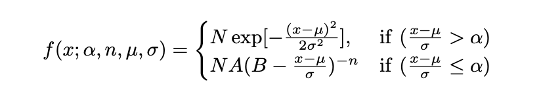
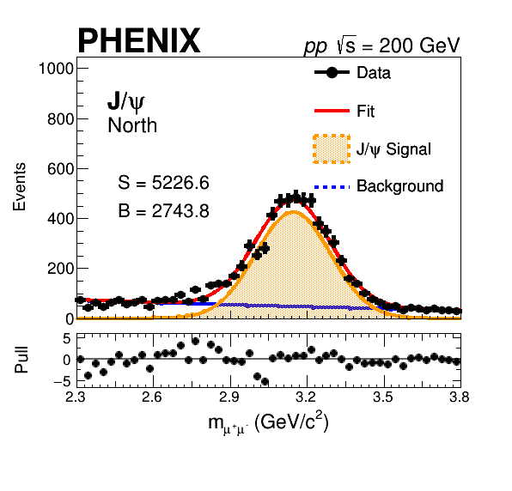
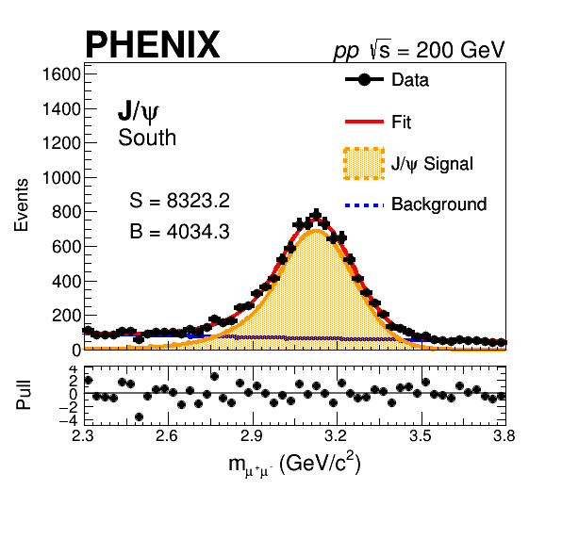
Fitting Improvement
Improvement of fitting
Signal model: change double crystal ball -> single crystal ball
Fit convergence and closure verified
Refering to the published J/ψ analysis: improve the fit by first fitting the inclusive north and south FVTX J/ψ distributions and then fix α and n of the CB to fit the multiplicity bins
4

Slide 5
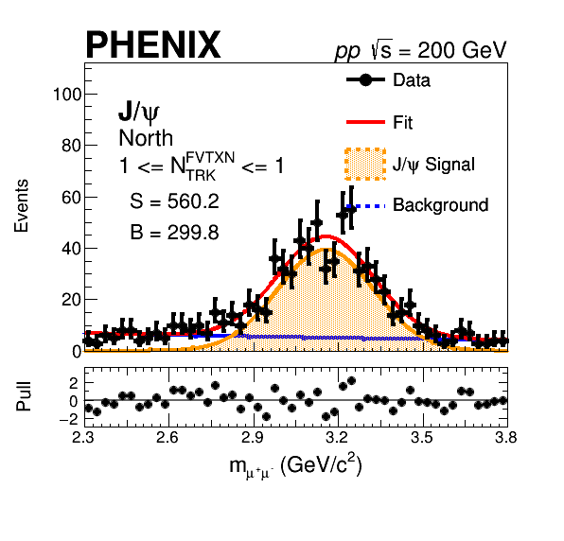
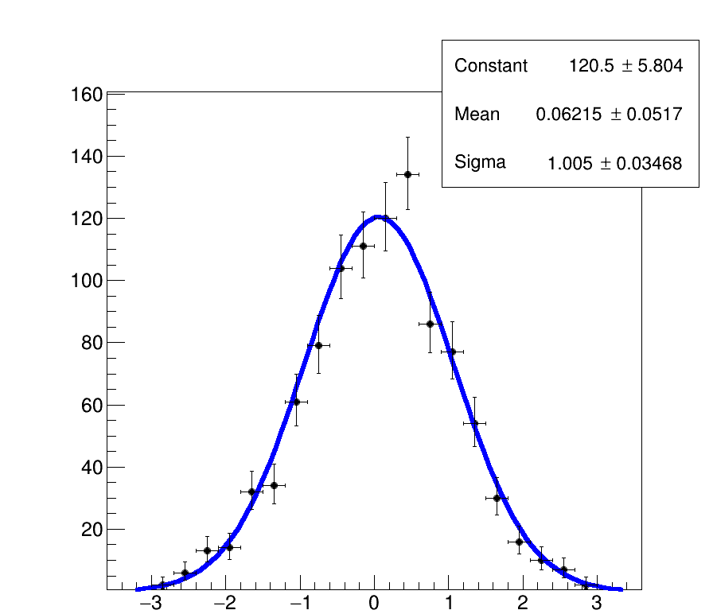
North J/ψ Fit Results for FVTXN N_{ch} = 1
The fit looks reasonable
Unit pull is obtained
-> Closure test passed
-> Correct estimation of the signal raw yield mean and error from the unbinned fit
5

Slide 6
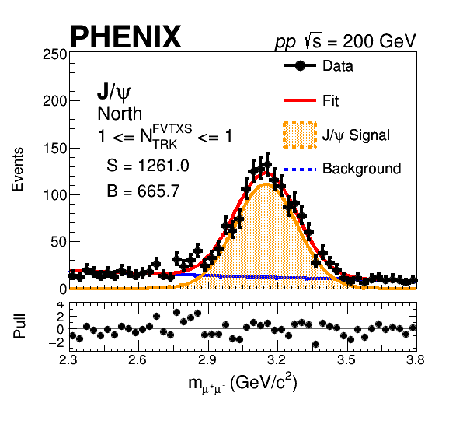
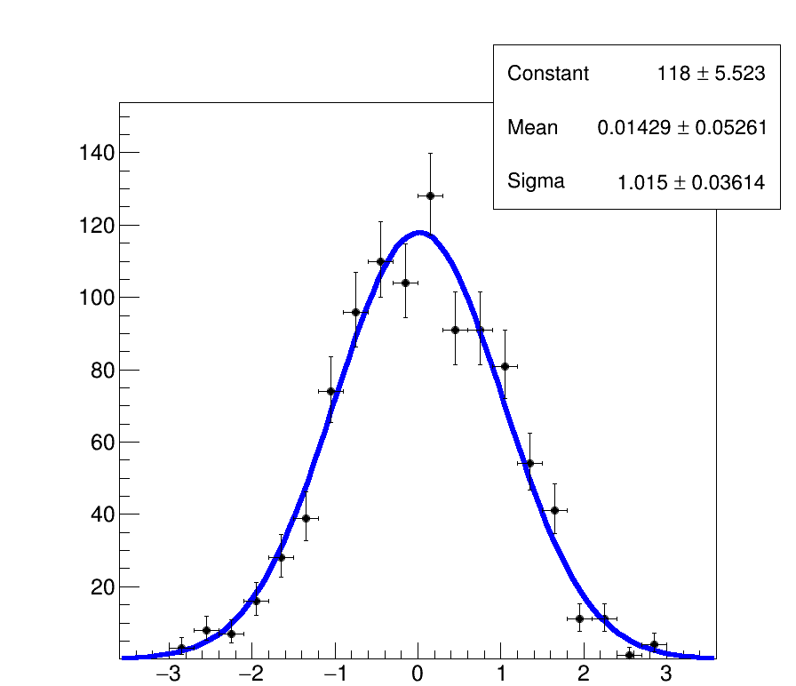
North J/ψ Fit Results for FVTXS N_{ch} = 1
Again, the fit looks reasonable
Unit pull is obtained
-> Closure test passed
-> Correct estimation of the signal raw yield mean and error from the unbinned fit
6

Slide 7
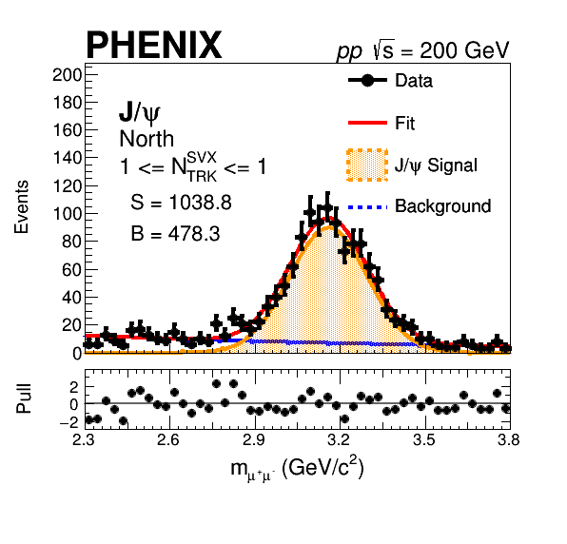
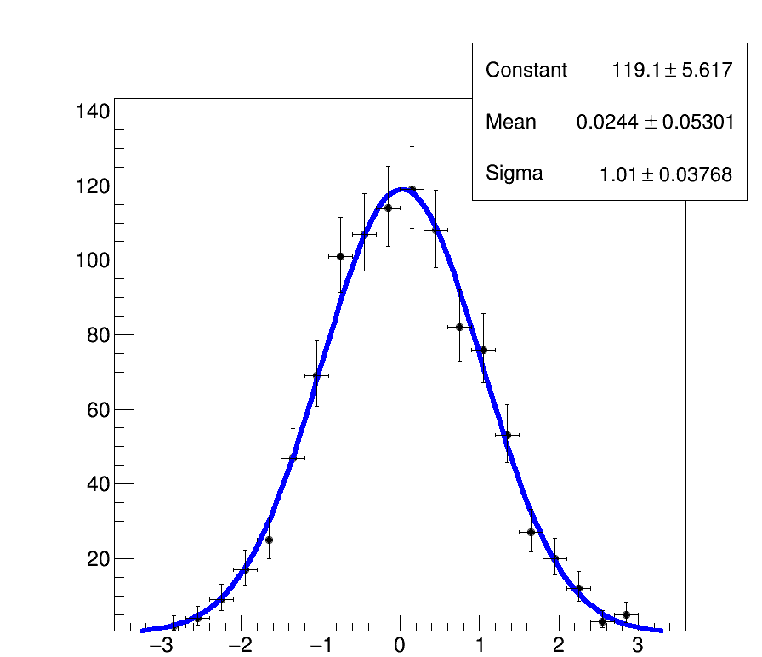
North J/ψ Fit Results for SVX N_{ch} = 1
Again, the fit looks reasonable
Unit pull is obtained
-> Closure test passed
-> Correct estimation of the signal raw yield mean and error from the unbinned fit
7

Slide 8

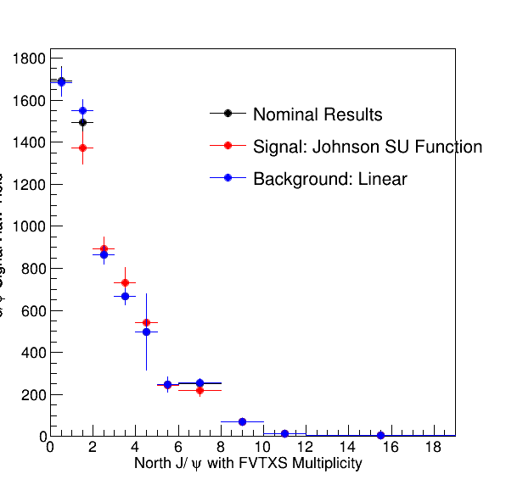
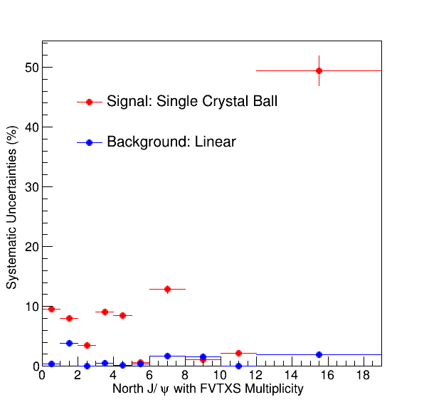
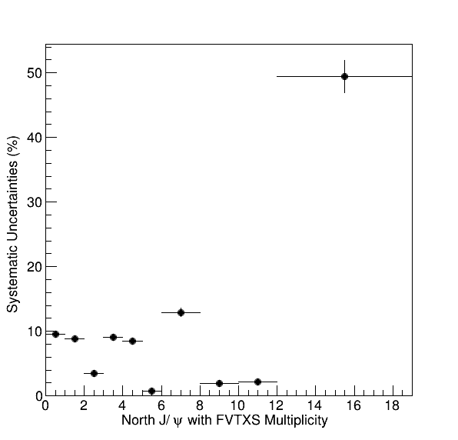
Fit Systematic Uncertainties Revisit
Change the variation of fits from single crystal ball to Johnson SU function
Potentially can use single Gaussian as variation as well
Significantly reduce fit systematic uncertainties
Here, as preliminary results, we quote a 10% systematic uncertainties for the fits
8

Slide 9
Double Collision Model
Study the sensitivity of the 1st empty/no-hit bin in the reference low BBC rate Evt_Mult_FVTX/SVX
Removed the 1st empty bin counts in the normalization, but still used it to calculate PDF2_model - overall scale change
Overall better agreement after removing the zero multiplicity bin
9

Slide 10
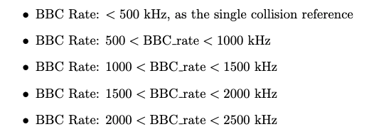

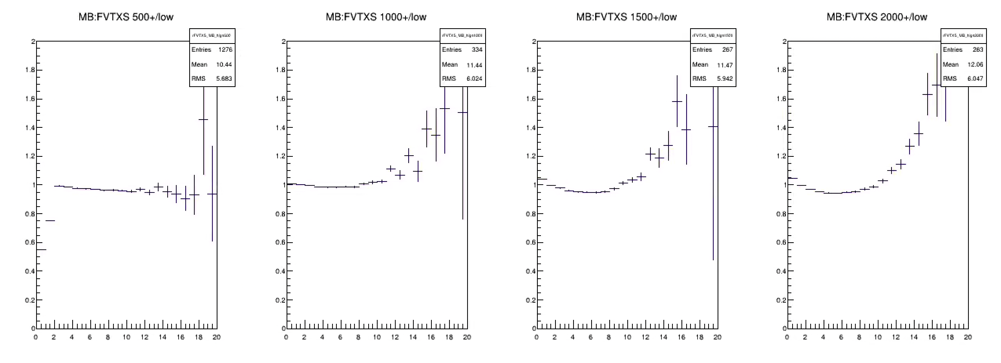
New Approach: BBC Rate Dependent Event Multiplicity Distributions
Study the event normalized Evt_Mult_FVTX/SVX distributions relative to the reference one from low BBC Rate runs (<500kHz)
New correction factor to be adopted for the final results and potentially reduce the systematic error
Not used currently for preliminary results
20% band
500-1000 kHz
1000-1500 kHz
1500-2000 kHz
2000-2500 kHz
Evt_Mult_FVTXS
Evt_Mult_FVTXS
Evt_Mult_FVTXS
Evt_Mult_FVTXS
10

Slide 11
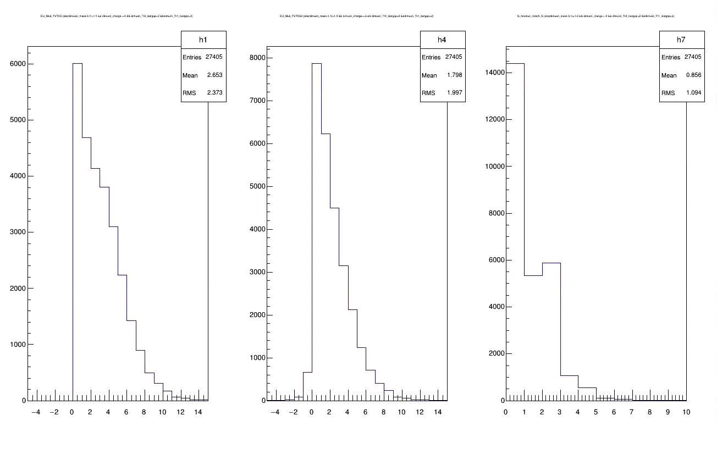
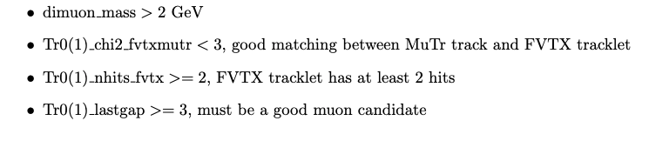
Muon-FVTX Matching Correction on the Same Arm
Dimuon:
associated FVTXs: dN
Evt_Mult_FVTXS
Evt_Mult_FVTXS – dN
(Done in Event-by-event correction)
Remove FVTX tracklets if from the muons in the Evt_Mult_FVTX counting
Small fraction of over-subtraction - if more than 1 pair of dimuons ….
11

Slide 12

Modification on the FVTX Tracklet Multiplicity
There is an about p = 70% of probability that a muon matched to an FVTX tracklet
For the same arm, the average contribution of two muons from the J/ψ is given by the binominal distribution:
<ΔN> = Np = 2 × 0.7 = 1.4
We need to apply this correction to dimuon sample of North J/ψ on FVTXN and South J/ψ on FVTXS by recalculation the multiplicity (FVTXN/S -> FVTXN/S4)
The middle plot in the previous slide
12

Slide 13
Addition of J/ψ Trigger Systematics
Aside from MB trigger bias systematic, we also estimated the J/ψ trigger systematics due to the variation from multiplicity dependence
We believe the J/ψ trigger will be around 85% ± 10%
Quote a systematic uncertainties of 10% for J/ψ trigger efficiency bias uncertainties
13

Slide 14
Summary of Systematic Uncertainties
Sources of Systematic Errors | Systematic Uncertainties
J/ψ Signal Extraction | 10%
MB Trigger Bias | 5%
J/ψ Trigger Bias | 10%
Multiple Collision Modeling | 20%
J/ψ Reconstruction Efficiency | 15%
Total | 29.2%
Quote a systematic uncertainties of 29.2% all the data points in our final results
14

Slide 15
Final Results
Preliminary Figures
15

Slide 16
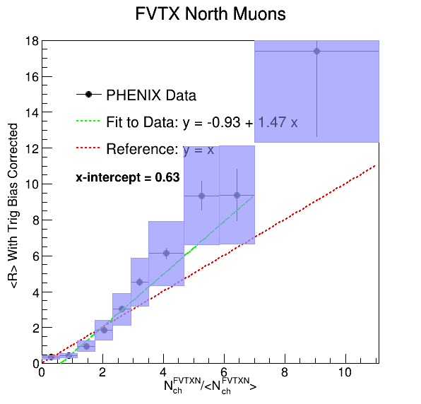
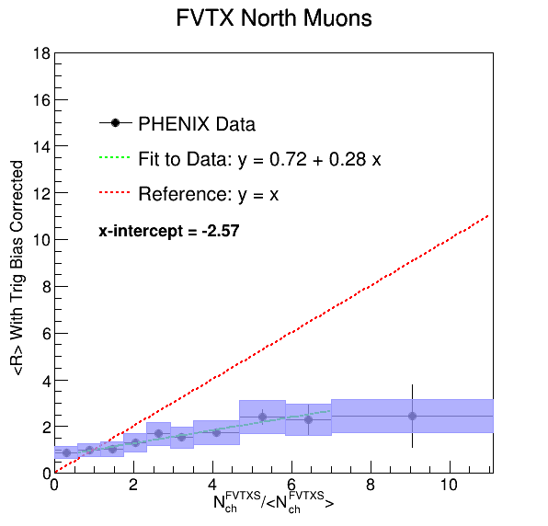
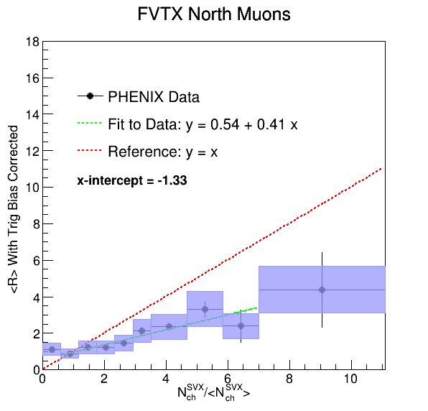
Preliminary Results – North J/ψ
Analysis Note Figure 75
Common scale for all plots in Y-axis: 0 – 18
Improve nominal values from better fit performance
Improved statistical due to more statistics
Better systematic uncertainties thanks to the improvement of the data analysis
16

Slide 17
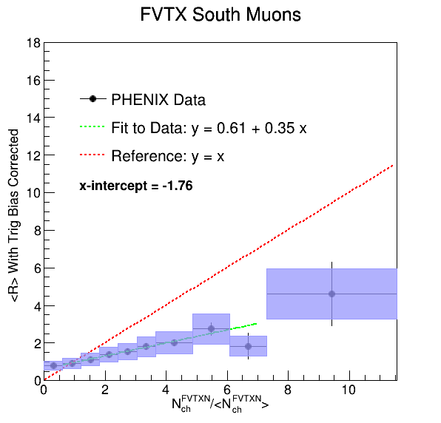
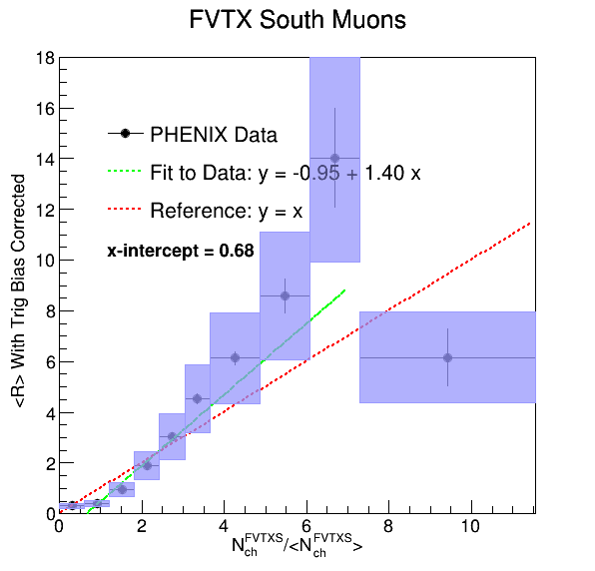
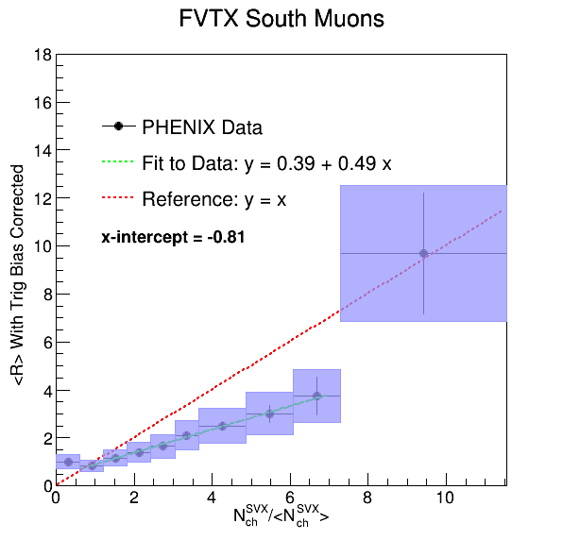
Preliminary Results – South J/ψ
Analysis Note Figure 76
Similar results to the North J/ψ
Improve nominal values from better fit performance
Improved statistical due to more statistics
Better systematic uncertainties thanks to the improvement of the data analysis
17

Slide 18
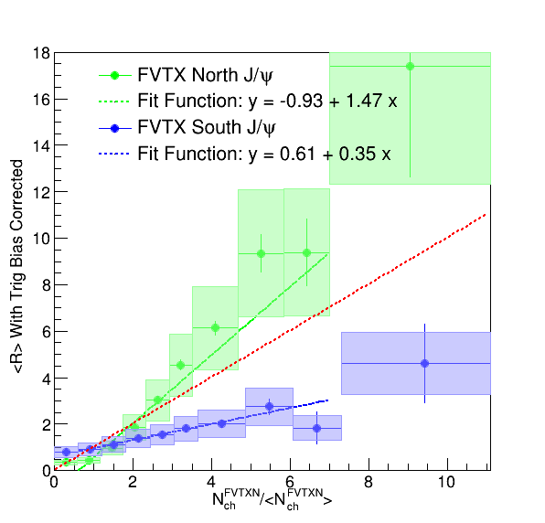
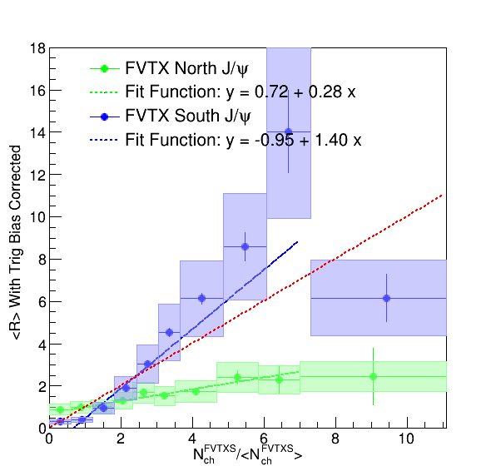
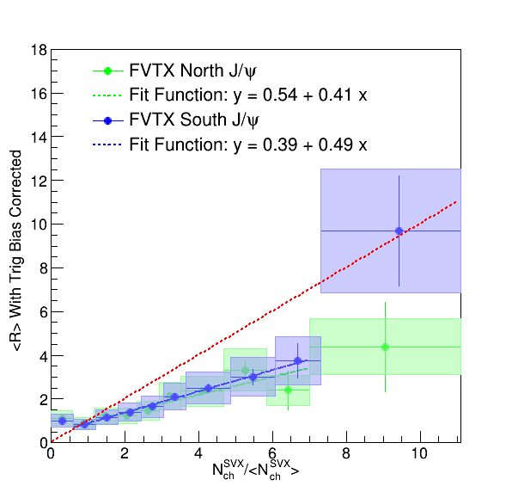
Preliminary Results – Plot Together
Analysis Note Figure 77
Overall good agreement for SVX in both north and south FVTX arms J/ψ
Different behavior for the same arm to opposite arm before corrections
Similar trends for North and South, which makes sense due to parity symmetry
18

Slide 19
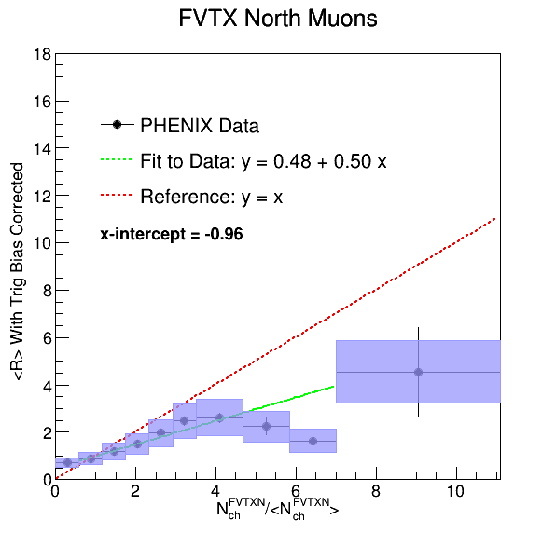
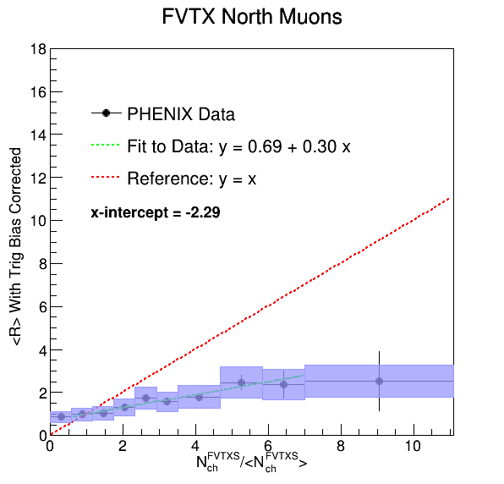
Preliminary Results – Dimuon Subtracted North J/ψ
Analysis Note Figure 80
Improve nominal values from better fit performance
Improved statistical due to more statistics
Better systematic uncertainties thanks to the improvement of the data analysis
Significantly better agreement between same and opposite arms after correction
19

Slide 20
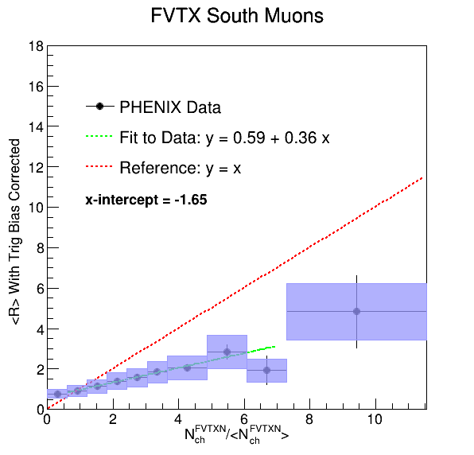
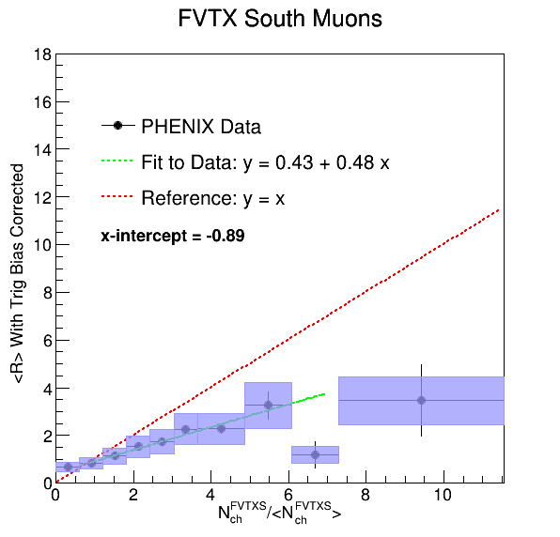
Preliminary Results – Dimuon Subtracted South J/ψ
Analysis Note Figure 81
Improve nominal values from better fit performance
Improved statistical due to more statistics
Better systematic uncertainties thanks to the improvement of the data analysis
Significantly better agreement between same and opposite arms after correction
20

Slide 21
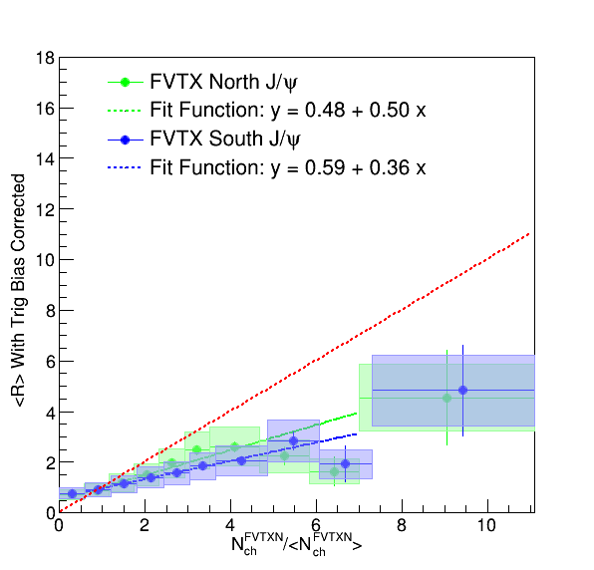
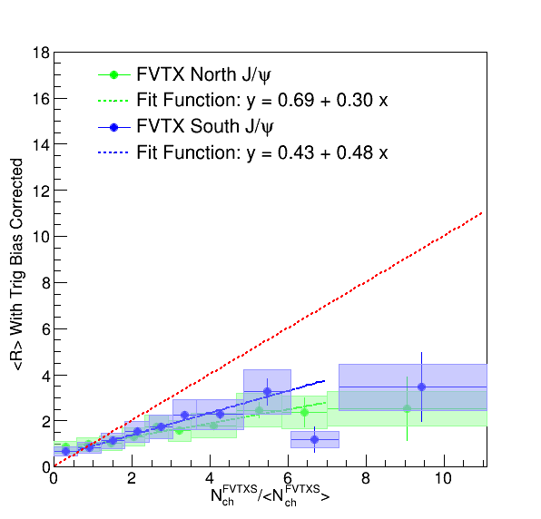
Preliminary Results – Dimuon Subtracted Plot Together
Analysis Note Figure 82
Excellent agreement of the results between the same arm and opposite arm after applying the correction
21

Slide 22
Additional Matrials
Supplementary Figure
22

Slide 23
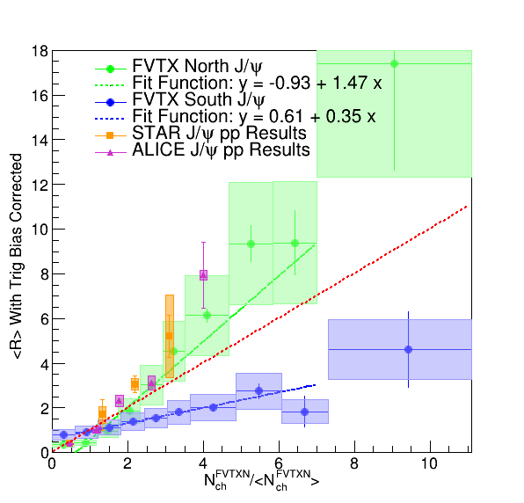
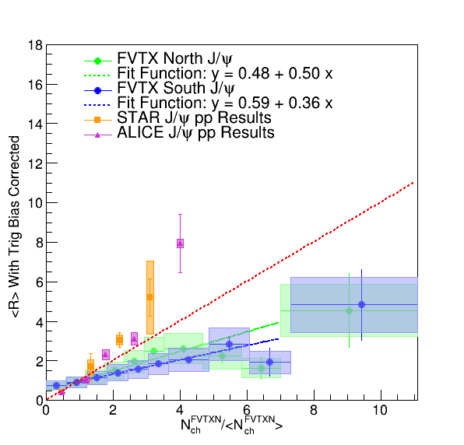
Comparison with Other Results – FVTXN
STAR Reference: PLB 786 (2018)
Overall very good agreement with STAR published results
Include theoretical calculations as well?
23

Slide 24
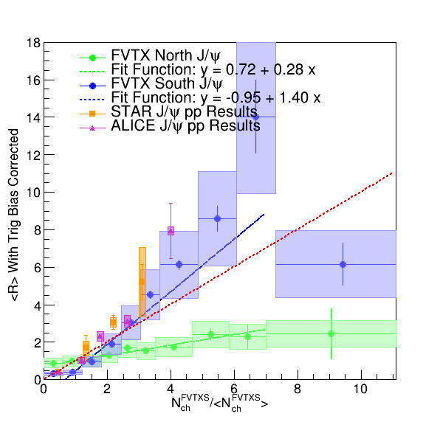
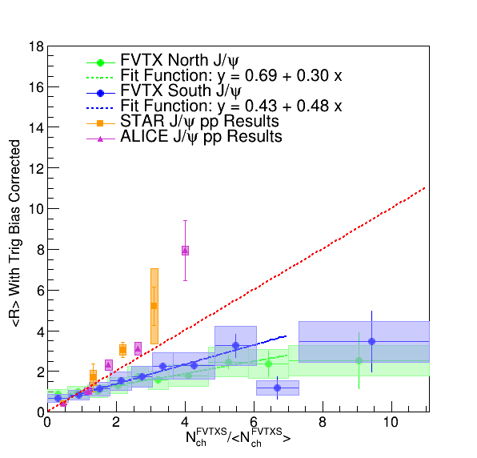
Comparison with Other Results – FVTXS
STAR Reference: PLB 786 (2018)
Overall very good agreement with STAR published results
Include theoretical calculations as well?
24

Slide 25
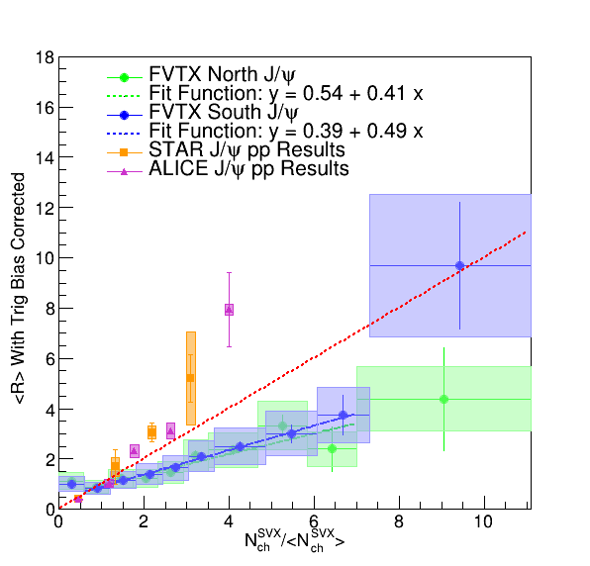
Comparison with Other Results – SVX
STAR Reference: PLB 786 (2018)
Overall very good agreement with STAR published results
Include theoretical calculations as well?
25

Slide 26
Summary
A lot of improvements have occurred over the last week
□ Increase the data sample statistics by a factor of 3
□ Improve of unbinned fits performance
□ Revisit the double collision model and better understand the systematics
□ Including J/ψ trigger efficiency bias systematic uncertainties
□ Apply corrections to remove J/ψ decay muons contributing to the same arm
Improve the nominal results as well as the statistical and systematic uncertainties
Obtain consistent results of same and opposite arms after the subtraction of dimuon tracklets on muon-FVTX matching to remove auto-correlation
Update the analysis notes to make it more readable
Request preliminary for Quark Matter 2022
26

